Slide 1
Introduction to Mathematical modelling
Concepts and Techniques
Ricardo Aguas

Slide 2
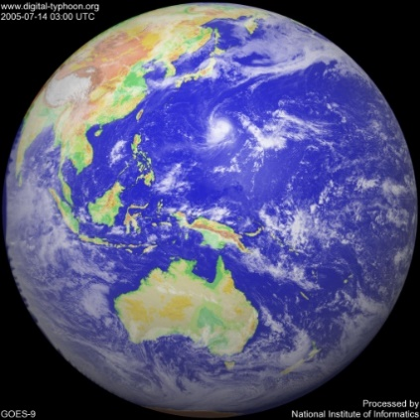
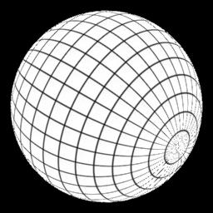
What is Mathematical Modelling?
A process that uses mathematics to represent, analyze, make predictions, or otherwise provide insight into real-world phenomena.
“Essence of mathematical modeling is the translation of an authentic real-world problem into a mathematical form.”
Develop model
Model Results
Real World
Maths World

Slide 3
Tractability
Making assumptions
Trial and error
Defining the problem
Validation
Research
Defining variables
Literature review

Slide 4
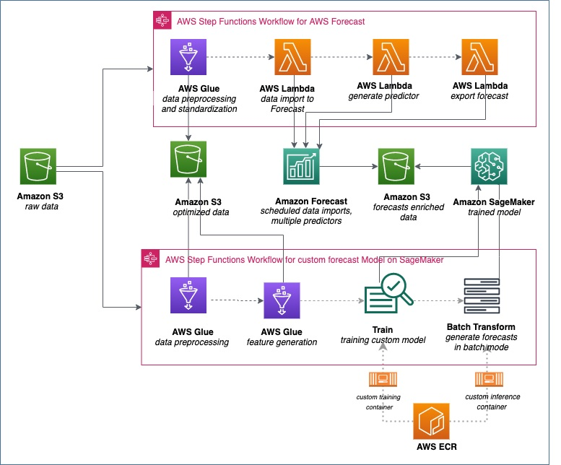

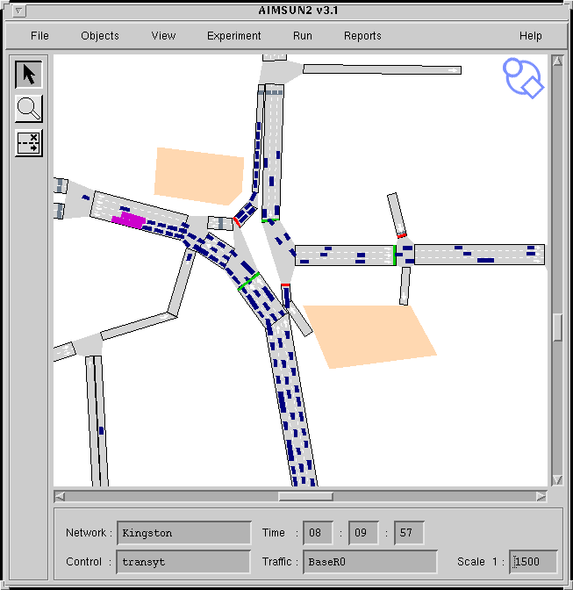

Examples of mathematical models
Weather forecast
Financial markets
Traffic solutions
Goods companies’ logistics

Slide 5
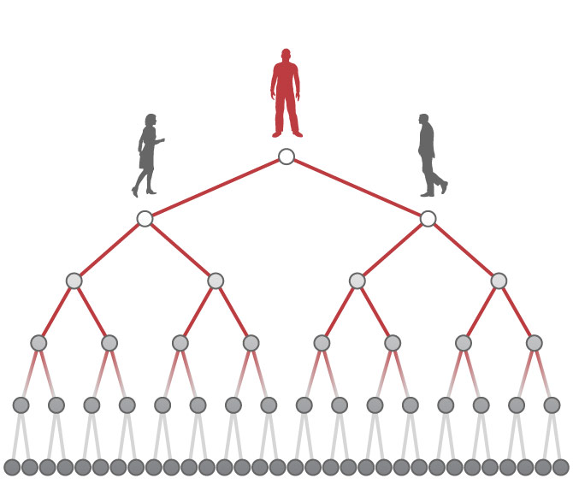
Outbreak investigation
Cases_{t} = 2^{t}

Slide 6
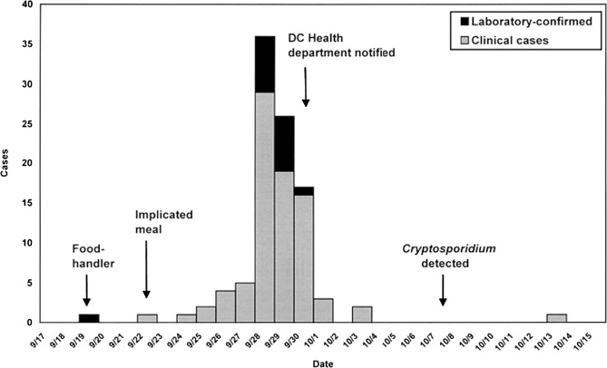
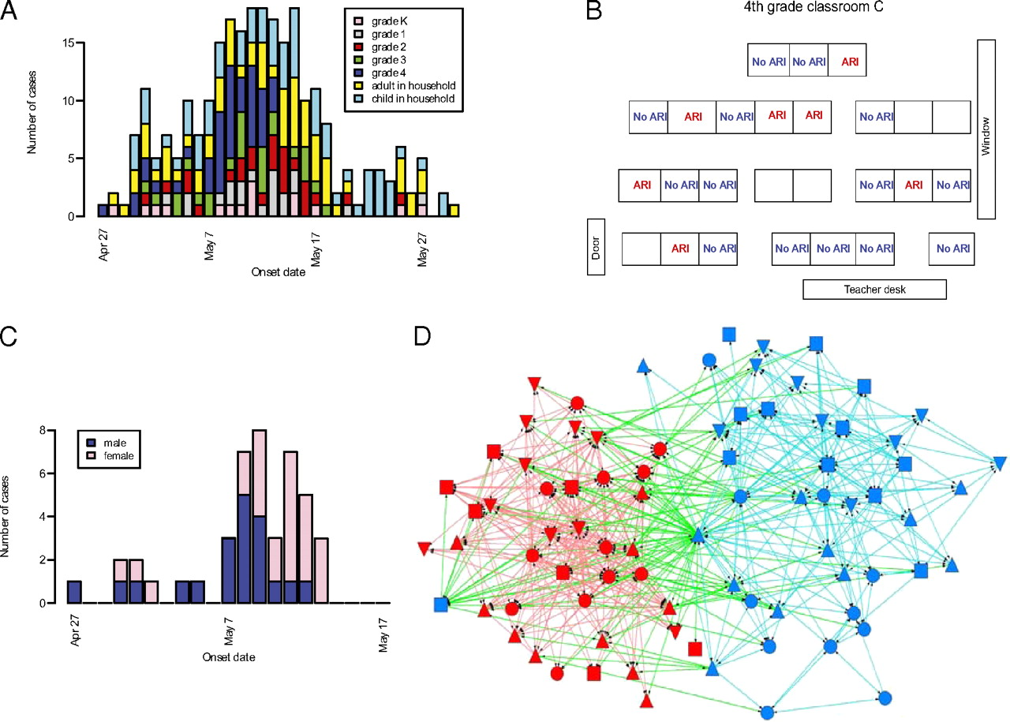
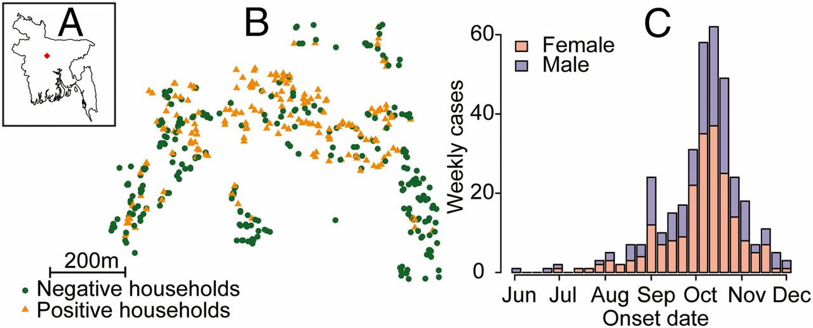
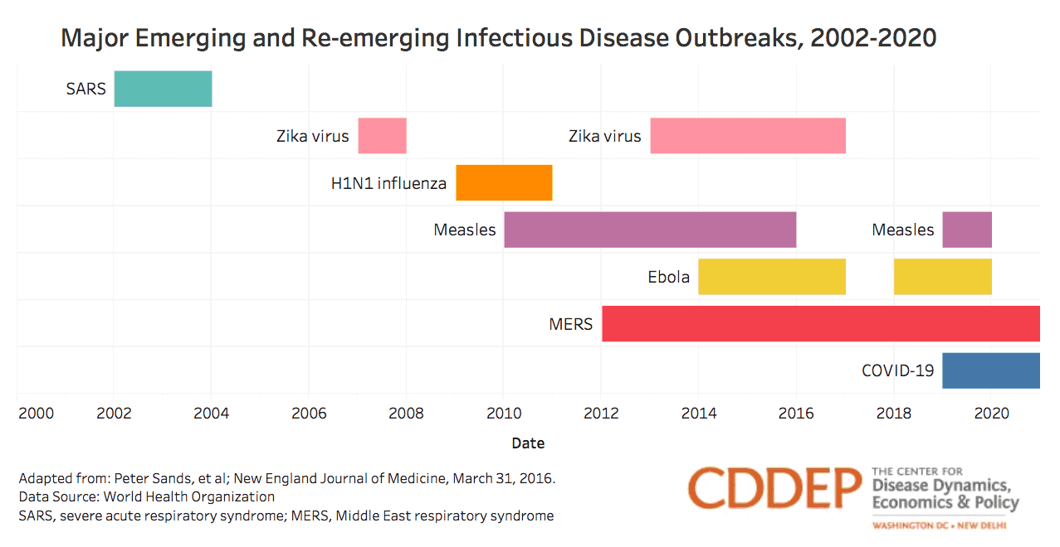
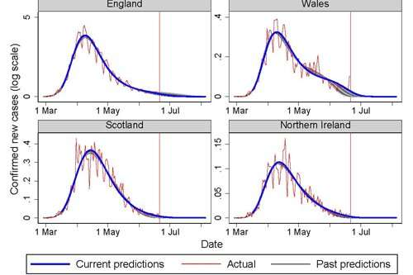
Outbreaks have a characteristic bell shape

Slide 8
How to think like an infectious disease modeller
Ferguson et al. Nature 425, 2003: 681-685

Slide 9
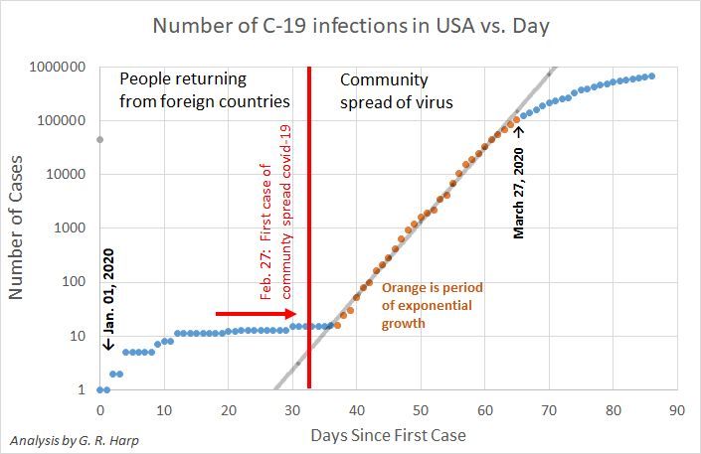

Slide 10
The characteristic bell-shaped curve
4 regions
Exponential, Saturation, Decline, Post epidemic behaviour
Distribution of notified cases of measles in Sri Lanka by week, January 1999 through June 2000
Puvimanasinghe et al. JID 2003, 187: S241-45

Slide 11

The Basic Reproduction number: R₀

Slide 12
The Basic Reproduction number: R₀
Basic
reproduction
number
Duration of infection
R₀ = p c D
R₀ is defined as the average number of secondary infections that result from a single infection introduced into a totally susceptible population
{
The effective contact
rate per unit time
Number of contacts
per unit time
Probability of infection
given a contact
Transmission rate/coefficient β

Slide 13
Exponential continued?
Exponential increase cannot continue since there is a limit to the number of individuals susceptible to infection
R₀=3
susceptible
infected
recovered

Slide 14
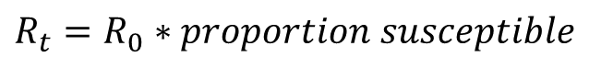
Saturation
Not all contacts are with susceptible individuals.
The effective reproduction number R_{t} is defined as:
the average number of new infections caused by an infected individual in a population.
changes with time.
$R_{t}=R_{0}∗proportion susceptible$

Slide 15
The speed at which an epidemic takes off and dies out is determined by R(t) = R₀ S(t)
R(t) = 1
R(t) < 1
R(t) > 1
R(t) ~ 0

Slide 16
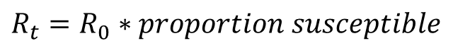
Saturation
Not all contacts are with susceptible individuals.
The effective reproduction number R_{t} is defined as:
the average number of new infections caused by an infected individual in a population.
changes with time.
Incidence of infections increases when R_{t}>1 and declines when R_{t}<1. Thus, the critical proportion susceptible, x*, can be calculated for R_{t}=1.
$R_{t}=R_{0}∗proportion susceptible$

Slide 17
Graph of a simulated epidemic
Susceptible
Infected

Slide 18
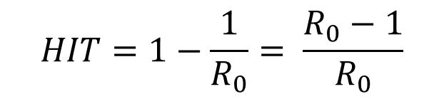
How to use this critical proportion x*?
e.g. Vaccination!
Critical proportion immune = 1 – x* = Herd immunity threshold (or is it?)
$$HIT=1−\frac{1}{R_{0}}= \frac{R_{0}−1}{R_{0}}$$

Slide 19
Herd Immunity threshold
It’s a metric of population susceptibility, not a metric of cumulative exposure.
HIT is a threshold condition, and population immunity is a continuous trait. These are not interchangeable.
It does not tell us when transmission has stopped. When HIT is reached, incidence is close to its highest.

Slide 20


Slide 21

HIT = 50%
Population
exposed = 50%
Population
susceptibility = 50%

Slide 23
HIT = 50%
Population
exposed = 33%
Population
susceptibility = 50%

Slide 24
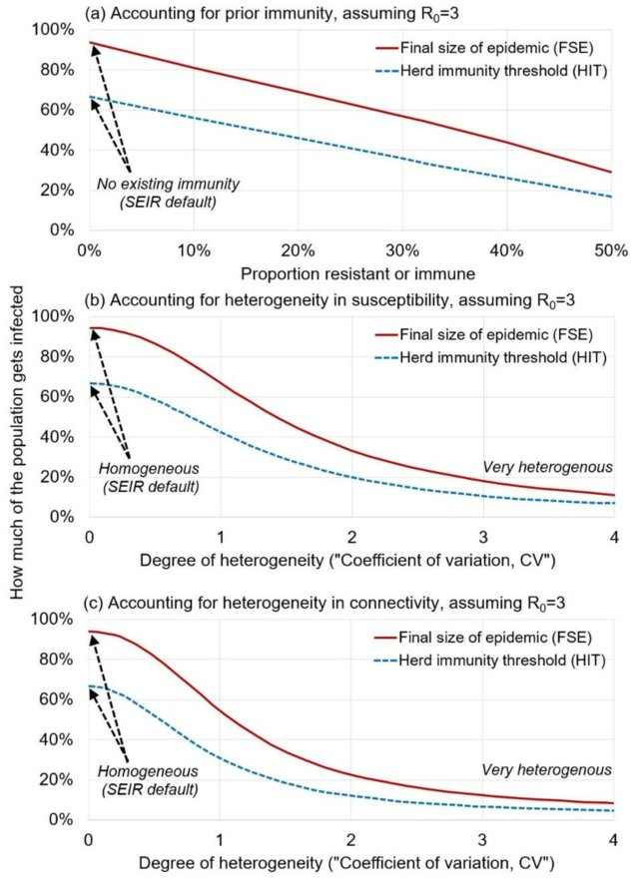

Slide 25
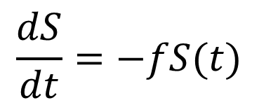
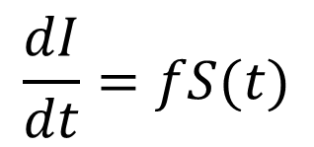
Compartmental models
Ordinary Differential Equations (ODEs)
Change from e.g. state S to state I
Each box (compartment, state) has an equation
Each arrow (flow) has a rate
RATE:
If individuals are in state S for d years then f=1/d
f
S
I
$$\frac{dS}{dt}=−fS(t)$$
what goes out of one state (-)
MUST enter another (+)
The rate is always multiplied by the number in the compartment it leaves at time (t)
$$\frac{dI}{dt}=fS(t)$$

Slide 26
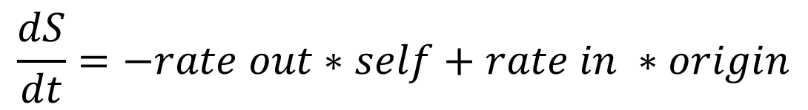
Compartmental Models
Each compartment (box) is a disease/infection state
Each arrow is a flow (rate) between two compartments (directional) and specifies the speed at which a transition between compartments occurs.
Described by a system of Ordinary Differential Equations (ODEs)
rate
S
I
rate
S
0
$$\frac{dS}{dt}=−rate out∗self+rate in ∗origin$$

Slide 27
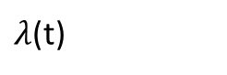
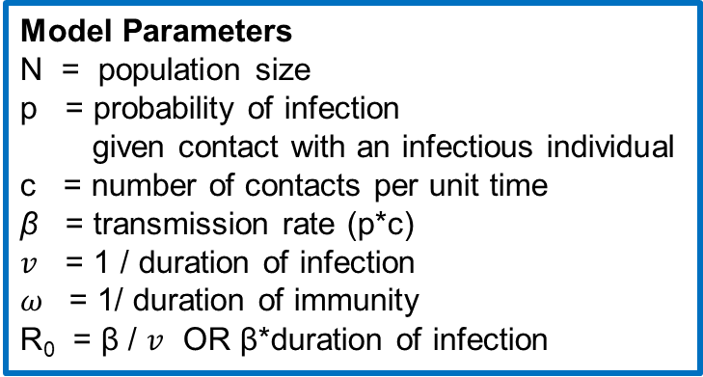
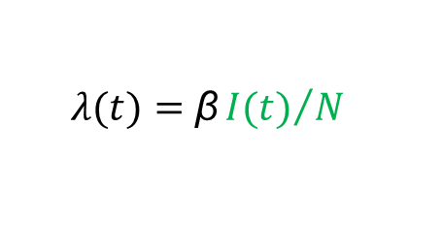
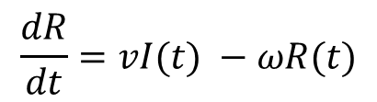
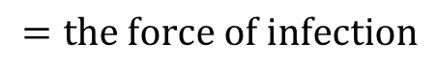
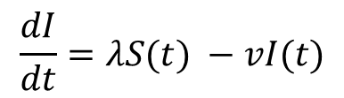

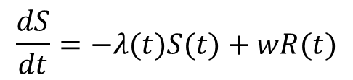

Example: The SIRS model
Has three states so has three equations
The rate at which susceptible individuals become infected is special because it depends on the proportion of the population that is infected per unit time (I(t)/N) = a dynamic transmission model!
loss of immunity
$$ω$$
Susceptible
transmission
Infectious
recovery
Recovered
$λ$(t)
$$v$$
$$λ(t)=\text{β}{I(t)}/N$$
$$=the force of infection$$
Model Parameters
N = population size
p = probability of infection
given contact with an infectious individual
c = number of contacts per unit time
β = transmission rate (p*c)
$v$ = 1 / duration of infection
$ω$ = 1/ duration of immunity
R₀ = β / $v$ OR β*duration of infection
$$\frac{dS}{dt}=−λ(t)S(t)+wR(t)$$
$$\frac{dI}{dt}=λS(t) −vI(t)$$
$$\frac{dR}{dt}=vI(t) −ωR(t)$$
Notes:
Ask for an example of an SIRS model;
Write the differential equations together on the board

Slide 28
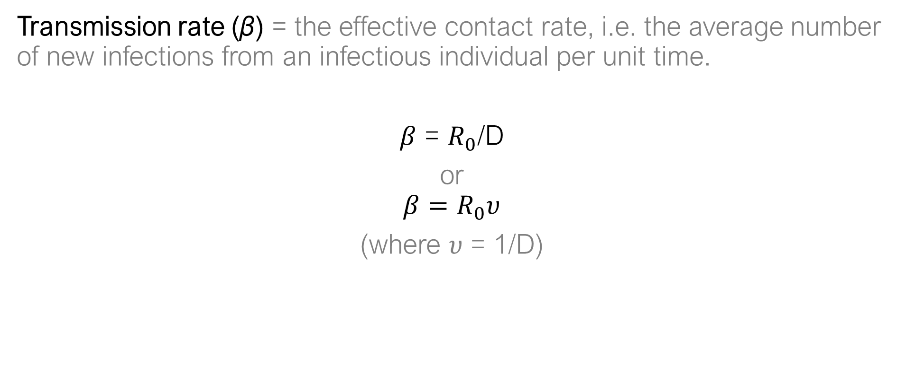
Transmission rate
Transmission rate ($\text{β}$) = the effective contact rate, i.e. the average number of new infections from an infectious individual per unit time.
$β$ = $R_{0}$/D
or
$$β=R_{0}υ$$
(where $υ$ = 1/D)

Slide 29
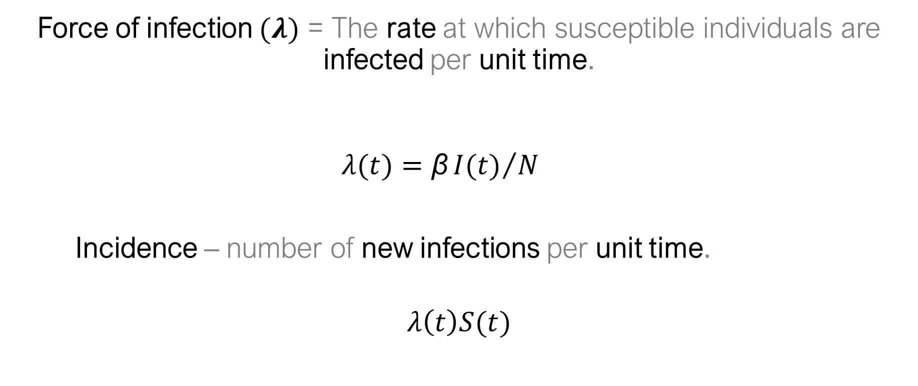
Force of infection
Force of infection $(λ)$ = The rate at which susceptible individuals are infected per unit time.
$$λ(t)=\text{β}{I(t)}/N$$
Incidence – number of new infections per unit time.
$$λ\left(t\right)S(t)$$
Notes:
Incidence = the number of new cases occurring per unit time

Slide 30
What do basic compartmental models assume?
Deterministic model structure.
No role of chance, model behavior is predetermined.
Population is stratified in broad groups (i.e. compartments).
Within each compartment, individuals are identical in all aspects.
Homogenous mixing.
Dynamic transmission.
Closed population.
Notes:
Ask students to think about the model assumptions. Ask students how the model could involve an open population

Slide 31
Common model structures
Susceptible
Infectious
SI
SIS
Susceptible
Infectious
SIR
Susceptible
Infectious
Recovered
SIRS
Susceptible
Infectious
Recovered

Slide 32
Infectious disease model “solutions”
If run for a suitably long time period, compartmental models reach a state where the numbers of individuals in each state remains constant over time
This means that every time an infected person recovers, they are replaced by a new person who becomes infected
This is known as a dynamic equilibrium
Susceptible
loss of immunity
transmission
Infected
recovery
Resistant

Slide 33
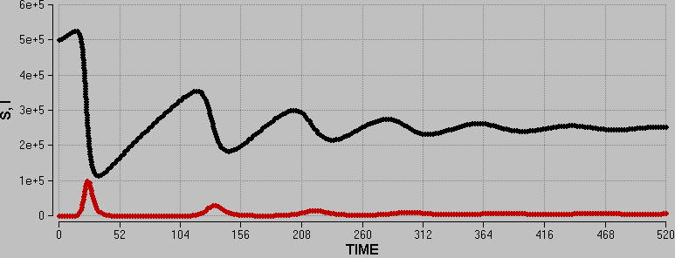
How do we approach the solution?
Let's see how S and I vary over time (10 years) in a SIRS model.
Endemic transmission
Equilibrium
Susceptibility is replenished
Epidemic
Susceptibility is replenished
Even smaller Epidemic
Smaller Epidemic

Slide 34
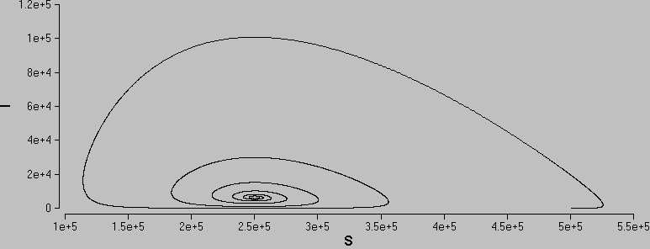
Phase Plots
A phase plot is a way of summarising how two state variables change with each other over time
S decreasing and I decreasing
S decreasing and I increasing
I reaches a peak
Equilibrium
S reaches a trough
Initial condition

Slide 35
Population Growth and Equations
Exponential growth
A bacterium divides every hour
Complete the table and sketch a graph of the population size
Time (hour) | Population Size
0 | 1
1 | 2
2 | 4
3 | 8
4
5
10
N=2^{t}

Slide 36
Difference Equations
Differential equations are in continuous time
where is the rate of growth
Difference equations are in discrete time
where δt is the time interval
First principle of population dynamics
Rate of change
with time

Slide 37
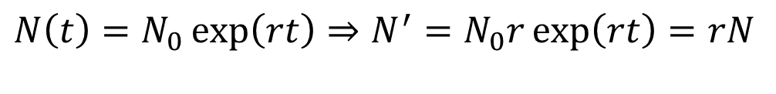
Solving differential equations
The aim is to find equations for the state variables in time.
The analytical solution is the exact solution.
- E.g. Show that is the analytical solution of the Malthusian Growth Equation where N₀ is the initial population size.
However it is not always possible to obtain the analytical solution (E.g. for the SIR model).
In this case, a numerical solution is necessary.
$$N\left(t\right)=N_{0}\exp\left(rt\right)⇒N^{′}=N_{0}r\exp\left(rt\right)=rN$$

Slide 38
The basis of numerical solution
Numerical solutions are based on discretising continuous time and approximating the differential.
The simplest approach is to approximate the solution as a series of straight lines
This is the difference equation approach
N
numerical solution
Rate of change
with time
What is the general relationship between error and step size?
Real solution
t
t
t+δt

Slide 39
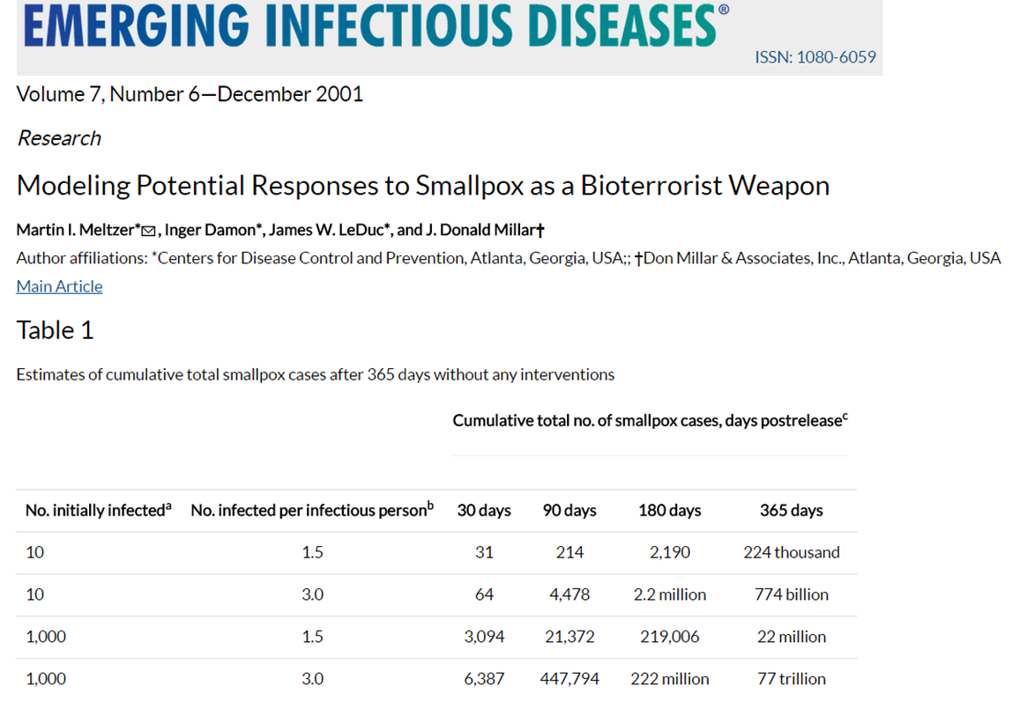
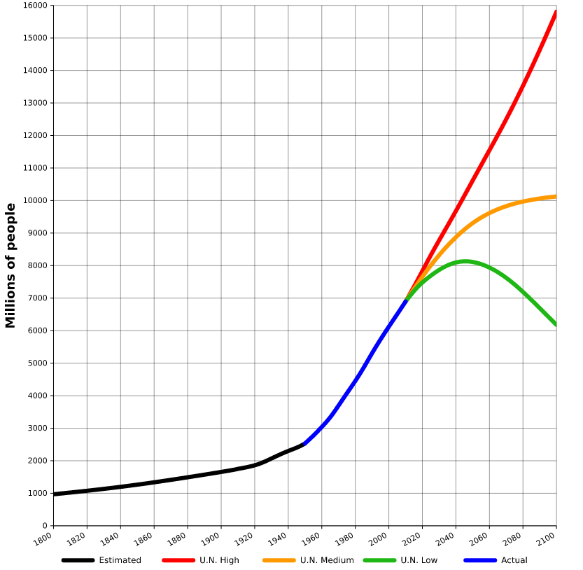
Exponential growth models aren’t ideal
"World-Population-1800-2100"
by Tga.D based on Aetheling's work - based on file:World-Population-1800-2100.png, but converted to SVG using original data from U.N. 2010 projections and US Census Bureau historical estimates. Licensed under CC BY-SA 3.0 via Wikimedia Commons - https://commons.wikimedia.org/wiki/File:World-Population-1800-2100.svg#/media/File:World-Population-1800-2100.svg
16 trillion < 77 trillion
Spot the problem with the model prediction

Slide 40
Self-Limiting Growth
Logistic growth (Verhulst) model with carrying capacity, K
Calculate and sketch N_{t} for r = 0.69 hour⁻¹, N₀ = {1,0,50,200,300}, K = 200 and δt = 1 for 15 hours
Always approaches carrying capacity, except when starting at zero population.

Slide 41
Defining a steady state (equilibrium)
Consider the Verhulst model with carrying capacity, K
is the rate of change [or slope or gradient] at time t.
Zero gradient
equilibrium
Slope positive ⇒ pop increasing
Slope negative ⇒ pop decreasing
What happens when slope is zero?
Positive gradient

Slide 42
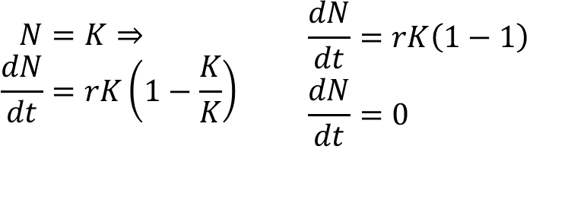
Finding the Equilibria of a Model
A system is at equilibrium when the slope is equal to zero.
Show that in the Verhulst model, , the rate of change of population is zero when N=K.
Is there another steady state?
$$\begin{matrix}\begin{aligned}N&=K⇒ \\ \frac{dN}{dt}&=rK\left(1−\frac{K}{K}\right)\end{aligned} & & \begin{aligned}\frac{dN}{dt}&=rK\left(1−1\right) \\ \frac{dN}{dt}&=0\end{aligned}\end{matrix}$$

Slide 43
Practical Session 1

Slide 44
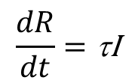
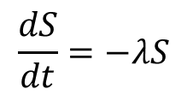
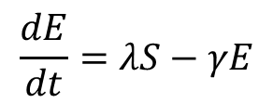
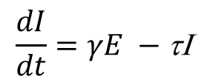
Compartmental model building - SEIR
Write down the model diagram and accompanying ODE system for an SEIR model. Use whatever letters you wish to designate the parameters. Ignore disease induced mortality for now.
S
λ
E
γ
I
τ
R
$$\frac{dS}{dt}=−λS$$
$$\frac{dE}{dt}=λS−γE$$
$$\frac{dI}{dt}=γE −\text{t}\text{I}$$
$$\frac{dR}{dt}=\text{t}\text{I}$$

Slide 45
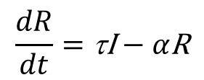
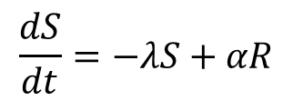
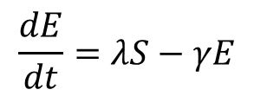
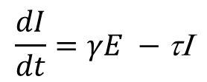
Compartmental model building - SEIRS
Write down the model diagram and accompanying ODE system for an SEIRS model. Use whatever letters you wish to designate the parameters. Ignore disease induced mortality for now.
S
λ
E
γ
I
τ
R
α
$$\frac{dS}{dt}=−λS+αR$$
$$\frac{dE}{dt}=λS−γE$$
$$\frac{dI}{dt}=γE −\text{t}\text{I}$$
$$\frac{dR}{dt}=\text{t}\text{I}−α\text{R}$$

Slide 46
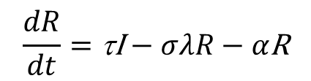
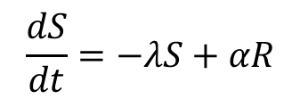
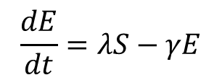
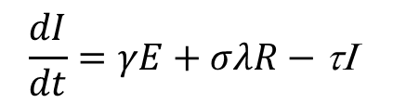
Compartmental model building - SEIR^{I}S
Now consider that after an initial infection, individual recover with only partial immunity, i.e., recovered individuals can be infected again at a lower rate compared to fully susceptible individuals. How would you include that in the model? Draw the diagram and write down the equations.
S
λ
E
γ
I
τ
R
σλ
α
$$\frac{dS}{dt}=−λS+αR$$
$$\frac{dE}{dt}=λS−γE$$
$$\frac{dI}{dt}=γE+σλR−\text{t}\text{I}$$
$$\frac{dR}{dt}=\text{t}\text{I}−σλR−α\text{R}$$

Slide 47
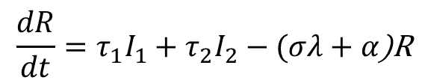
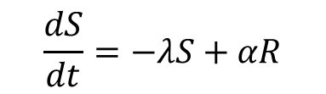
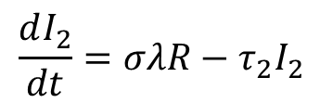
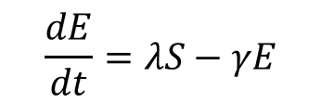
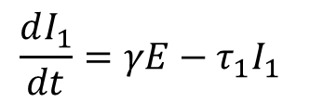
Compartmental model building - SEIR^{I}S
What if partial immunity, implies that a second infection will be shorter than the first? How would you include that in the model? Draw the diagram and write down the equations.
γ
σλ
S
λ
E
I₁
τ₁
R
I₂
τ₂
α
$$\frac{dS}{dt}=−λS+αR$$
$$\frac{dE}{dt}=λS−γE$$
$$\frac{dI_{1}}{dt}=γE−τ_{1}I_{1}$$
$$\frac{dR}{dt}=τ_{1}I_{1}+τ_{2}I_{2}−(σλ+α\text{)}\text{R}$$
$$\frac{dI_{2}}{dt}=σλR−τ_{2}I_{2}$$

Slide 48

Let’s see how the dynamics change with key parameter changes
https://www.epidemix.app/

Slide 49
Run the SIR model with parameters
N = 1000
I(t=0) = 1
Beta= 0.4
Recovery from infection = 5 days
Timeline = 365 days
Download the csv files and plot them in R.

Slide 50
Import the csv files
Epidemix_import.R
This is the working directory we will be working from all week. Please store ALL files from canvas on this folder
setwd('C:/mgh - mmid’)
app<-read.csv('SIR.csv', header = T)
app
This is how you import a csv file onto R, preserving the column names (header row).
Make a (S,I) phase plot
Note that plotting a matrix or dataframe produces multiple plots simultaneously
plot(app$S, app$Is)
plot(app)
plot(app[,c(2,5,6)])
You can select which columns to look at

Slide 51

Coding mathematical models – SIR
Let’s use a similar coding template to the one you’ve seen during the R programming module. Remember this?
Step 1 - Let’s translate these differential equations into an R function.
Step 2 - Define the initial conditions of the system.
Step 3 - Assign baseline values to the parameters.
Step 4 - Define the simulation timeline.
Step 5 - Solve the model (integrate the differential equations) with the ode function from the deSolve package.

Slide 52



Step 1 - Let’s translate these differential equations into an R function (starting with SIR).
Epidemix_import.R
$$\frac{dS}{dt}=−λS$$
$$\frac{dI}{dt}=λS−\text{t}\text{I}$$
$$\frac{dR}{dt}=\text{t}\text{I}$$
SIR_model<-function(t, state, parameters) {
with(as.list(c(state, parameters)),{
P <- (S+I+R)
lam<-parameters['beta’]*I/P
dS <- mu*P-mu*S-lam*S
dI <- lam*S-tau*I-mu*I
dR <- tau*I-mu*R
list(c(dS, dI, dR))})
}
Note the function arguments
Using the with function allows you to use the names of variables and parameters directly
Always make sure that P is the sum of all model variables
Make sure you have the right force of infection
List the output variables at the end

Slide 53
Step 2 - Define the initial conditions of the system.
Epidemix_import.R
initP<-99
initI<-1
initR<-0
initS<-initP-initI-initR
istate <- c(S = initS, I = initI, R = initR)
You need at least one infected individual to seed infection
istate is the list of initial conditions for the ODE system
Step 3 - Assign baseline values to the parameters.
parameters <- c(
mu=(1/(50*52*7)),
beta=0.4,
tau=1/10
)
Be mindful of the time scale. All parameters need to be in the same time units.

Slide 54
Step 4 - Define the simulation timeline.
Epidemix_import.R
time_start <- 0
time_stop <- 365
deltat<- 0.1
tps <- seq(time_start , time_stop , by = deltat)
deltat determines the integration step for the numerical solver
Step 5 - Solve the model (integrate the differential equations) with the ode function from the deSolve package.
out <- deSolve::ode(y = istate, times = tps, func = SEIR_model, parms = parameters)
Explore the options available in the ode function

Slide 55
Plot the SIR model results and compare them to app’s results
Epidemix_import.R
out2 <- deSolve::ode(y = istate, times = app$X, func = SIR_model, parms = parameters)
plot(out2[,1],out2[,3])
lines(app$X,app$Is, col="red")
For the comparison to be valid, we will use the app’s timeframe (app$X). We then overlay two solutions on top of each other.
Let’s adapt the SIR code and incorporate loss of immunity.
SIRS_model<-function(t, state, parameters) {
with(as.list(c(state, parameters)),{
P <- (S+I+R)
lam<-parameters['beta’]*I/P
dS <- mu*P-mu*S-lam*S+alpha*R
dI <- lam*S-tau*I-mu*I
dR <- tau*I-mu*R-alpha*R
list(c(dS, dI, dR))})
}
We don’t need additional variables.
We just have to add a rate from R to S.

Slide 56
What parameters would you need to change to get more frequent epidemic peaks? Would increasing the transmission rate do it?
Epidemix_import.R
Add alpha to the list of parameters and give it a value
parameters['alpha']<-1/150
out <- deSolve::ode(y = istate, times = tps, func = SIRS_model, parms = parameters)
plot(out[,1],out[,3])
parameters['beta']<-parameters['beta']*5
out_high_beta <- deSolve::ode(y = istate, times = tps, func = SIRS_model, parms = parameters)
lines(out_high_beta[,1],out_high_beta[,3],col="red")
parameters['beta']<-parameters['beta']/10
out_low_beta <- deSolve::ode(y = istate, times = tps, func = SIRS_model, parms = parameters)
lines(out_low_beta[,1],out_low_beta[,3],col="blue")
parameters['beta']<-0.4
parameters['alpha']<-parameters['alpha']*5
out_high_alpha <- deSolve::ode(y = istate, times = tps, func = SIRS_model, parms = parameters)
lines(out_high_alpha[,1],out_high_alpha[,3],col="magenta")
parameters['alpha']<-parameters['alpha']/10
out_low_alpha <- deSolve::ode(y = istate, times = tps, func = SIRS_model, parms = parameters)
lines(out_low_alpha[,1],out_low_alpha[,3],col="green3")
Change beta and re-run the model
Change beta and re-run the model
Reset beta and change alpha
Change alpha again

Slide 57
Compare the HITs for the SIR and SIRS models. Which is largest? Why?
Epidemix_import.R
Change alpha back to default value
parameters['alpha']<-1/150
out_sir <- deSolve::ode(y = istate, times = tps, func = SIR_model, parms = parameters)
out_sirs <- deSolve::ode(y = istate, times = tps, func = SIRS_model, parms = parameters)
plot(out_sir[,2],out_sir[,3])
lines(out_sirs[,2],out_sirs[,3],col="red")
lines(rep(2500,4000),1:4000)
parameters['alpha']<-1/50
out_sirs2 <- deSolve::ode(y = istate, times = tps, func = SIRS_model, parms = parameters)
lines(out_sirs2[,2],out_sirs2[,3],col="green3")
Add vertical line with expected HIT
Does loss of immunity impact HIT at all?

Slide 58


Epidemic vs Endemic
The long-term dynamics of a system are determined by how susceptibility to infection is implemented (pathogen dependent)
Equilibrium reached
Equilibrium?
© Copyright 2019, Intellectual Ventures Management, LLC (IVM). All rights reserved.

Slide 59

Equilibria
If run for a suitably long time period, simple compartmental models reach a state where the numbers of individuals in each compartment remain constant over time
This means that every time an infected person recovers, they are replaced by a new person who becomes infected $\frac{dI}{dt}=0$
This is known as a dynamic equilibrium
SI model – can you determine I at equilibrium analytically?
Does it match the R code output?
N = S + I <=> S = N-I
$$\frac{dI}{dt}=βS\frac{I}{N} − γI$$
$$βS\frac{I}{N} − γI=0⇒βI\left(1−\frac{I}{N}\right)−γI=0$$
$$I=\left(\frac{β−γ}{β}\right)N⇒ \left(1−\frac{γ}{β}\right)N$$

Slide 60


Equilibria
SIRS model
N = S + I + R
Not solvable
$$\frac{dI}{dt}=β(N−R−I)\frac{I}{N} − γI$$

